Slide 1

Automated Speaker Verification - A Study in Deep Neural Networks and Transfer Learning
COMP9444 Neural Networks and Deep Learning
Yash Khandelwal, Ahmet Karatas, Damian Basso and Armaan Bhullar
School of Computer Science and Engineering
Faculty of Engineering
The University of New South Wales, Sydney, Australia

Slide 2

The Rise of Language Models
Photo Credit: Image by Free-photos from Pixabay. https://pixabay.com/photos/road-winding-street-bridge-1030789/

Slide 3
Motivation

Slide 4
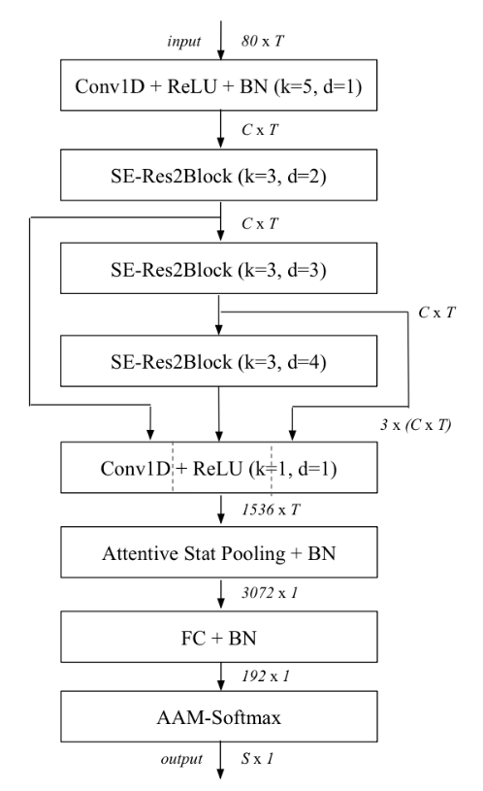
Network Architecture
<Add text here>
Source: Desplanques, B., Thienpondt, J., & Demuynck, K. (2020). ECAPA-TDNN: Emphasized Channel Attention, Propagation and Aggregation in TDNN Based Speaker Verification. Interspeech.

Slide 5
Project Demonstration
<Add text here>

Slide 6
Possible Improvements

Slide 7
Summary
…

Slide 8
References
[1] Desplanques, B., Thienpondt, J., & Demuynck, K. (2020). ECAPA-TDNN: Emphasized Channel Attention, Propagation and Aggregation in TDNN Based Speaker Verification. Interspeech.

Slide 9
Questions?

